Slide 1
SPAM MESSAGES FILTER
(Usinng svM and naïve bayes ):Tushar singh

Slide 2
SMS filters importance
Due to the spread of fake messages and spam messages by spammer
theres a lot of clickbait so filtering it using ML would just make our life less buggy
Due to this there are many fake messages which lets to the money scams through messages
This not only saves our data and time but make our digital life more secure

Slide 3
Data Acquisition and Cleaning
The data has been acquired by Kaggle dataset UCI_MACHINE LEARNING DATASET . The SMS Spam Collection is a set of SMS tagged messages that have been collected for SMS Spam research. It contains one set of SMS messages in English of 5,574 messages, tagged acording being ham (legitimate) or spam.
The files contain one message per line. Each line is composed by two columns: v1 contains the label (ham or spam) and v2 contains the raw text.
Data Cleaning (Removing unimportant data/ Stopwords/ Stemming)
Converting data into a model usable format (Bag of words/ Tfidf Model)

Slide 4
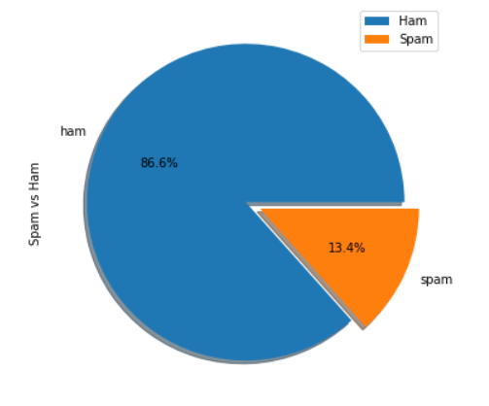
Proportion of Ham(Legit) and Spam in the Class

Slide 5
Features selection for training
In the data set we have renamed the v1 and v2 to class and text columns
The length of the messages ha been

Slide 6
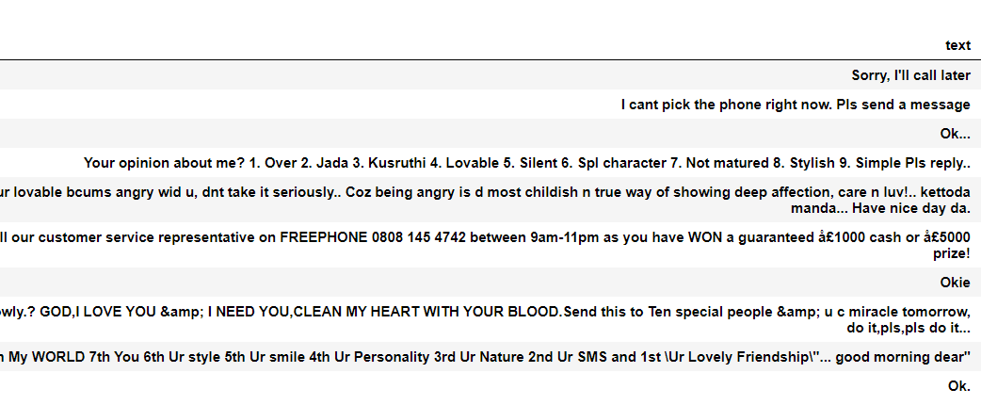
Here we can see that the messages which has greater length are ham messages thus we can add length as on of the feature
As the spam messages differ on many basis such as their context and pattern are different we can use it as an asset

Slide 7
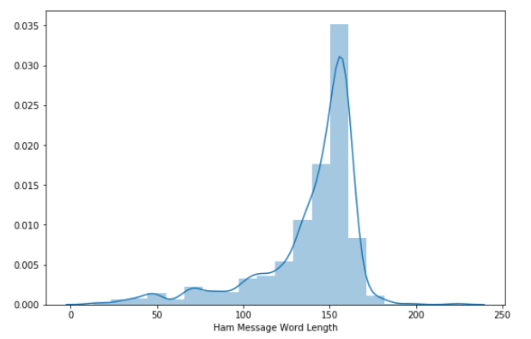
Ham messages length vs Spam messages length

Slide 8
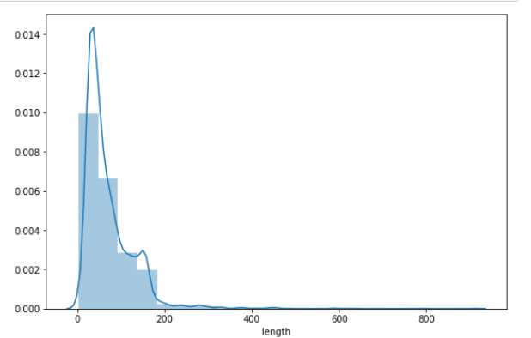

Slide 9
SVM Model
The following code trains and tests a SVM model using sklearn, The gamma value was achieved by playing around with the figure
We have selected “sigmoid” as the the kernel or model fitting equation
The Sorted and filtered dataset is splited with using python library of train_test_split.
I have selected gamma =1 for this model training.
After fitting the trained model we get an accuracy of 0.9874
Thus the model has been fitted well with the training dataset.
Although inorder to assure the data is not over fitted we have calculated accuracy score using test features which gives accuracy of 0.9784

Slide 10
Multinomial Naive Bayes Model
The following code trains and tests a Naïve Bayes model using sklearn, The alpha value was achieved by playing around with the figure
The Sorted and filtered dataset is splited with using python library of train_test_split.
I have selected gamma =0.2 for this model training after a lot of playing it can be done by for loop too.
After fitting the trained model we get an accuracy of 0.9854
Thus the model has been fitted well with the training dataset.
Although inorder to assure the data is not over fitted we have calculated accuracy score using test features which gives accuracy of 0.9961

Slide 11
Conclusion and Future scope:
Thus we can se from the predictions that Multinomial Naive Bayes Model worked more efficiently than the SVM model.
Thus such type of filters can be used in email spam and classification
Further using CNN and RNN we can form model for problems of Computer vision

Slide 13
END

